Slide 1
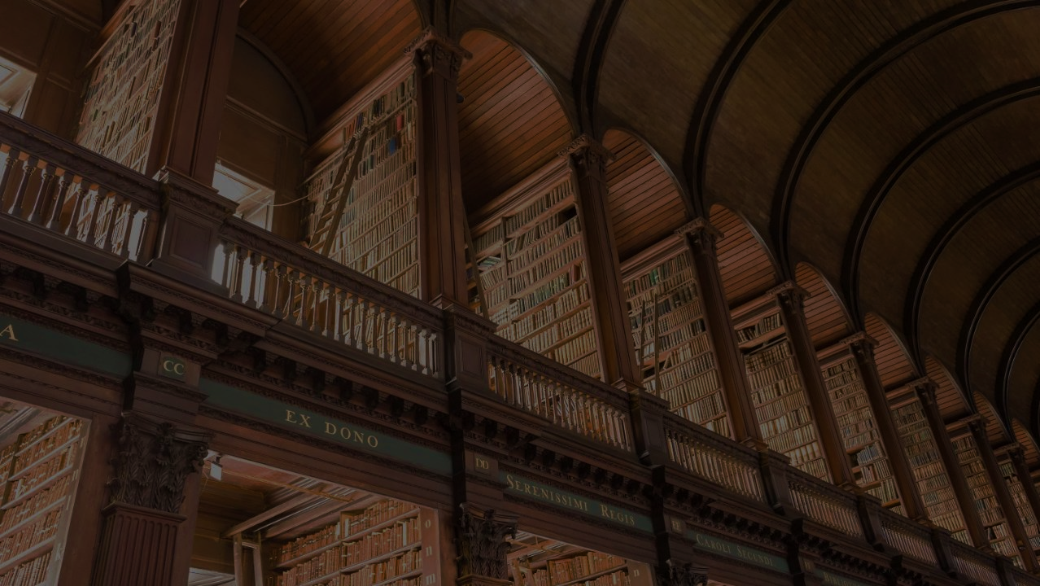
SmartLibraryApplication
Client - Greenfield Public Library
Submitted by
Meghana G S
Jeevan Sai Javvaji
Vedika Panchamahalkar
Chinnapareddy Yakkanti
Priyanka Yerumsetty

Slide 2
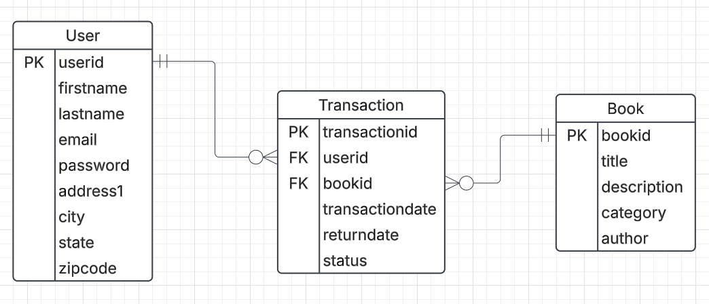
ERD

Slide 3
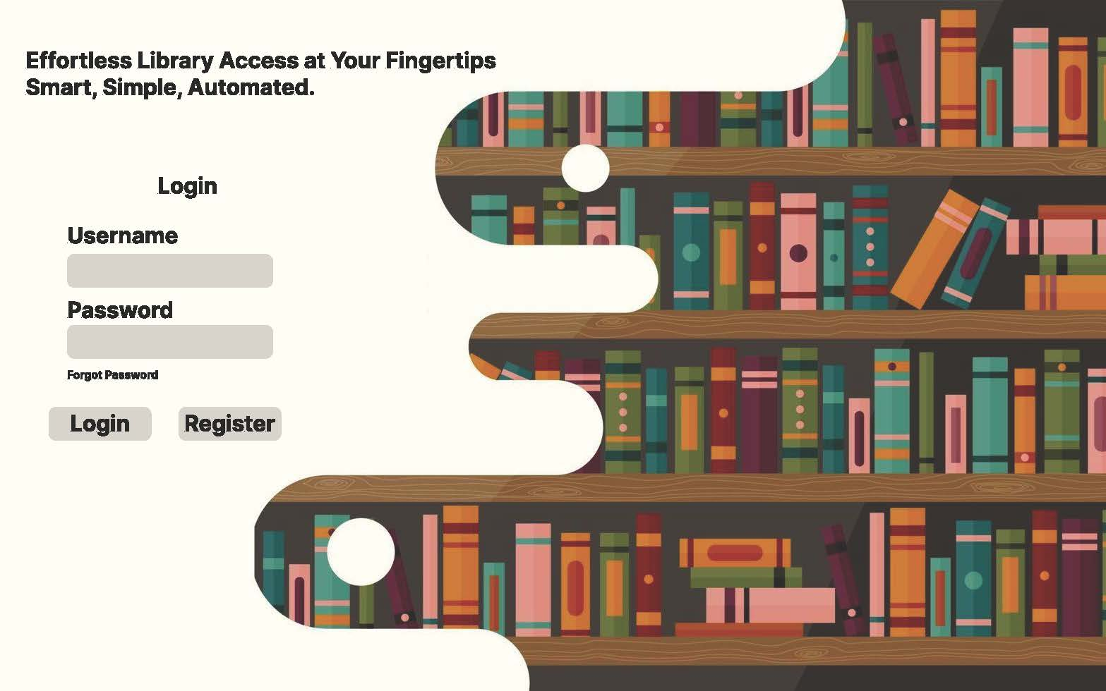
Login Screen

Slide 4
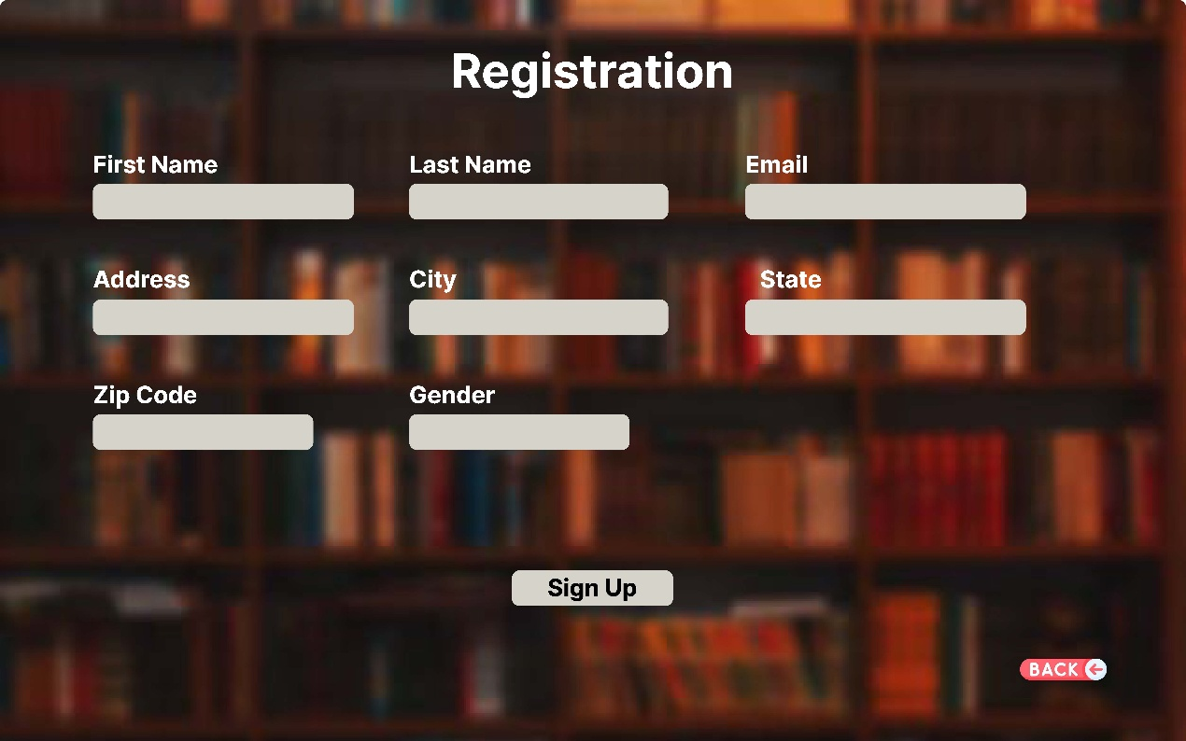
Registration Screen

Slide 5
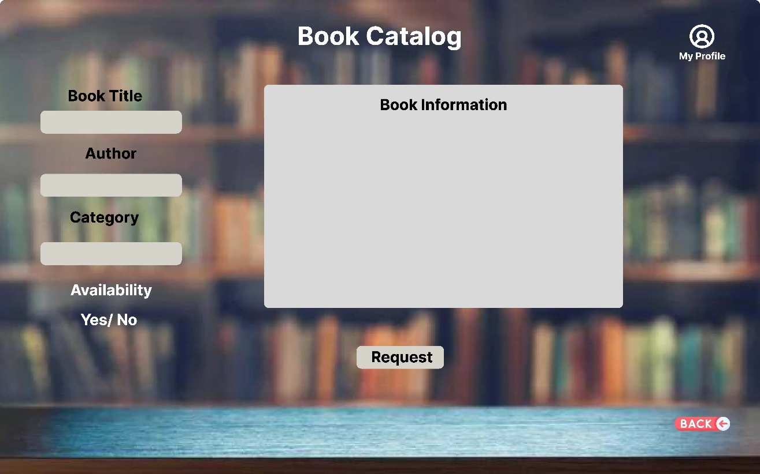
Book Browsing Screen

Slide 6
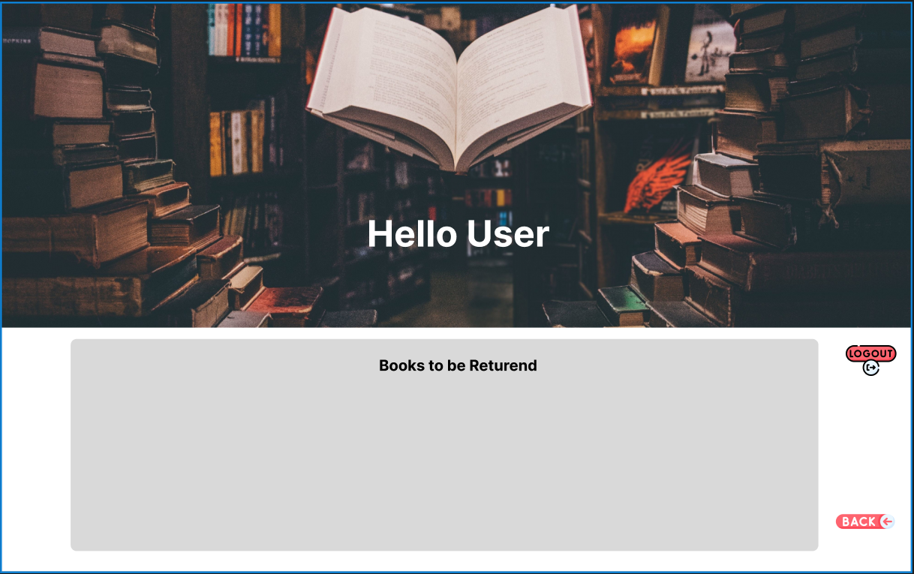
User Profile Screen

Slide 7
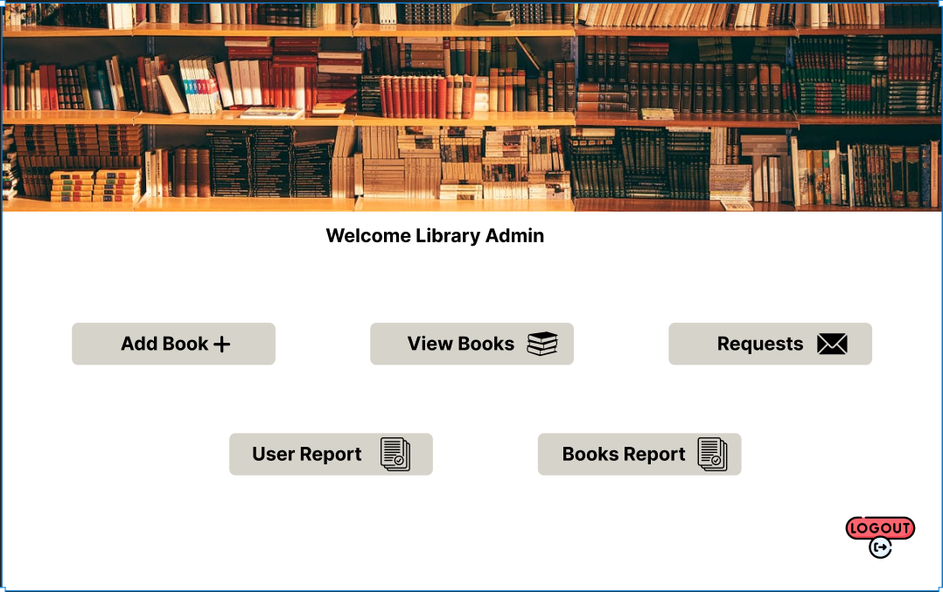
Admin Screen

Slide 8
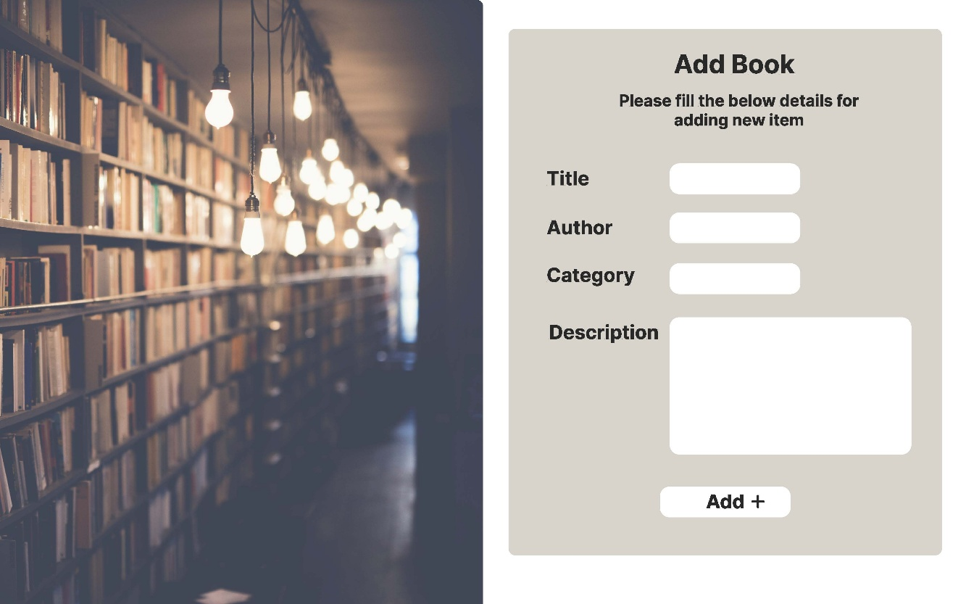
Add new Book Screen

Slide 9
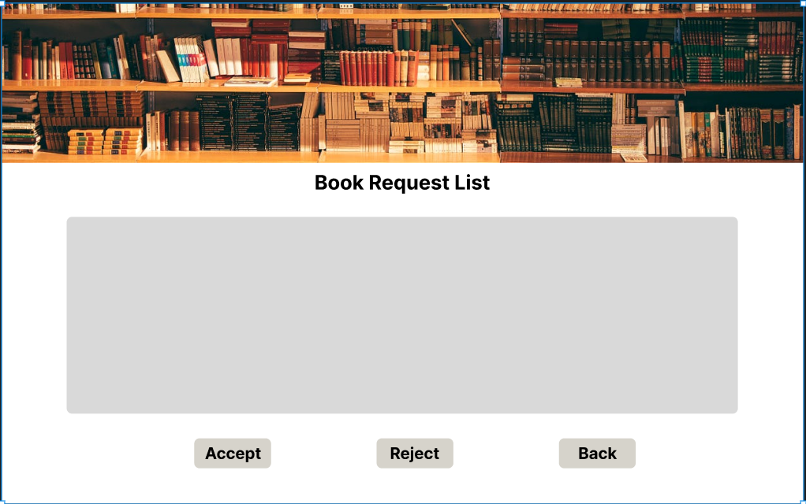
Admin Approval for books screen

Slide 10
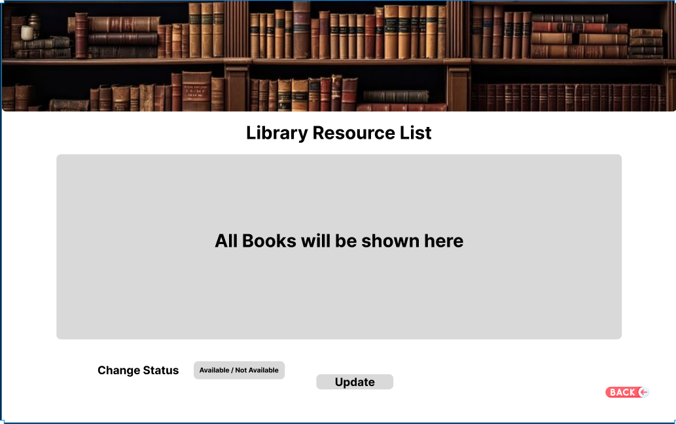
Library Resources list screen

Slide 11

Thank You

